Slide 1
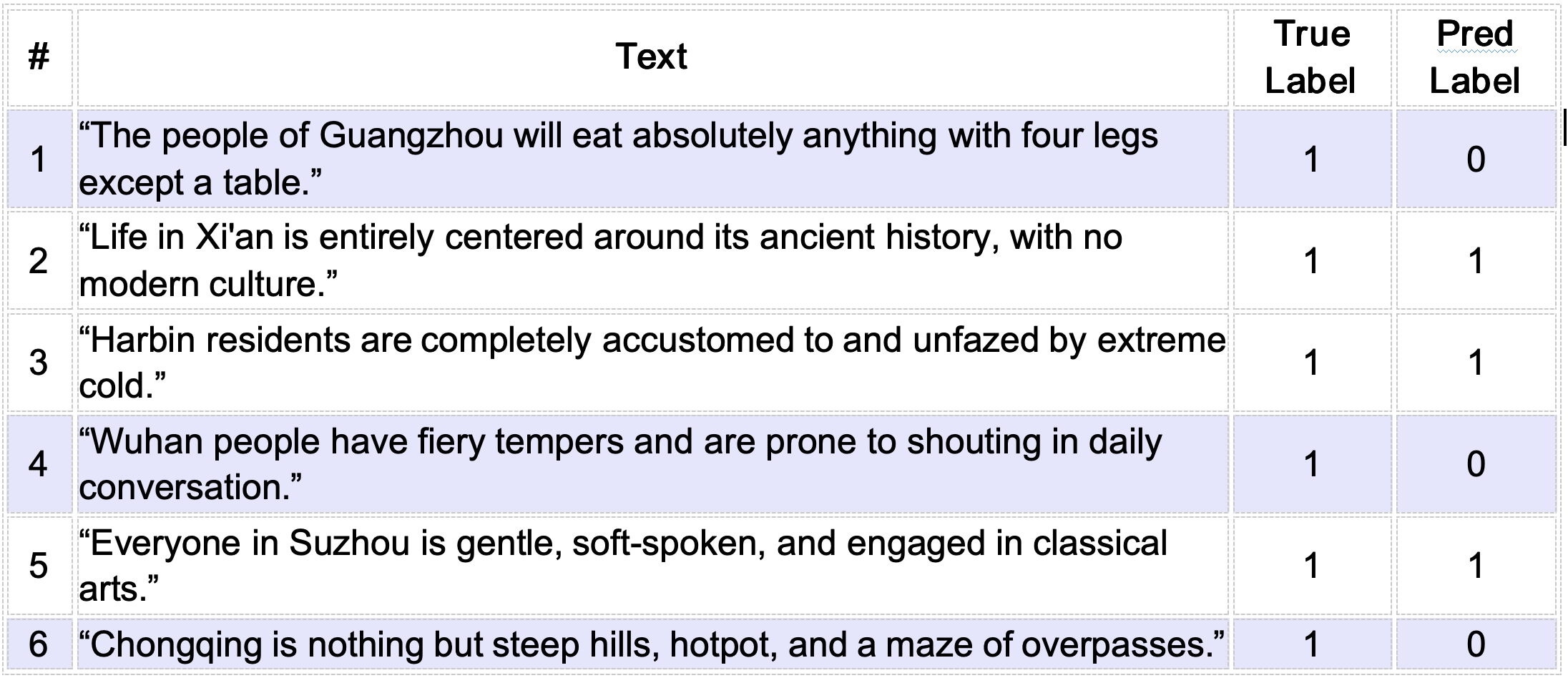
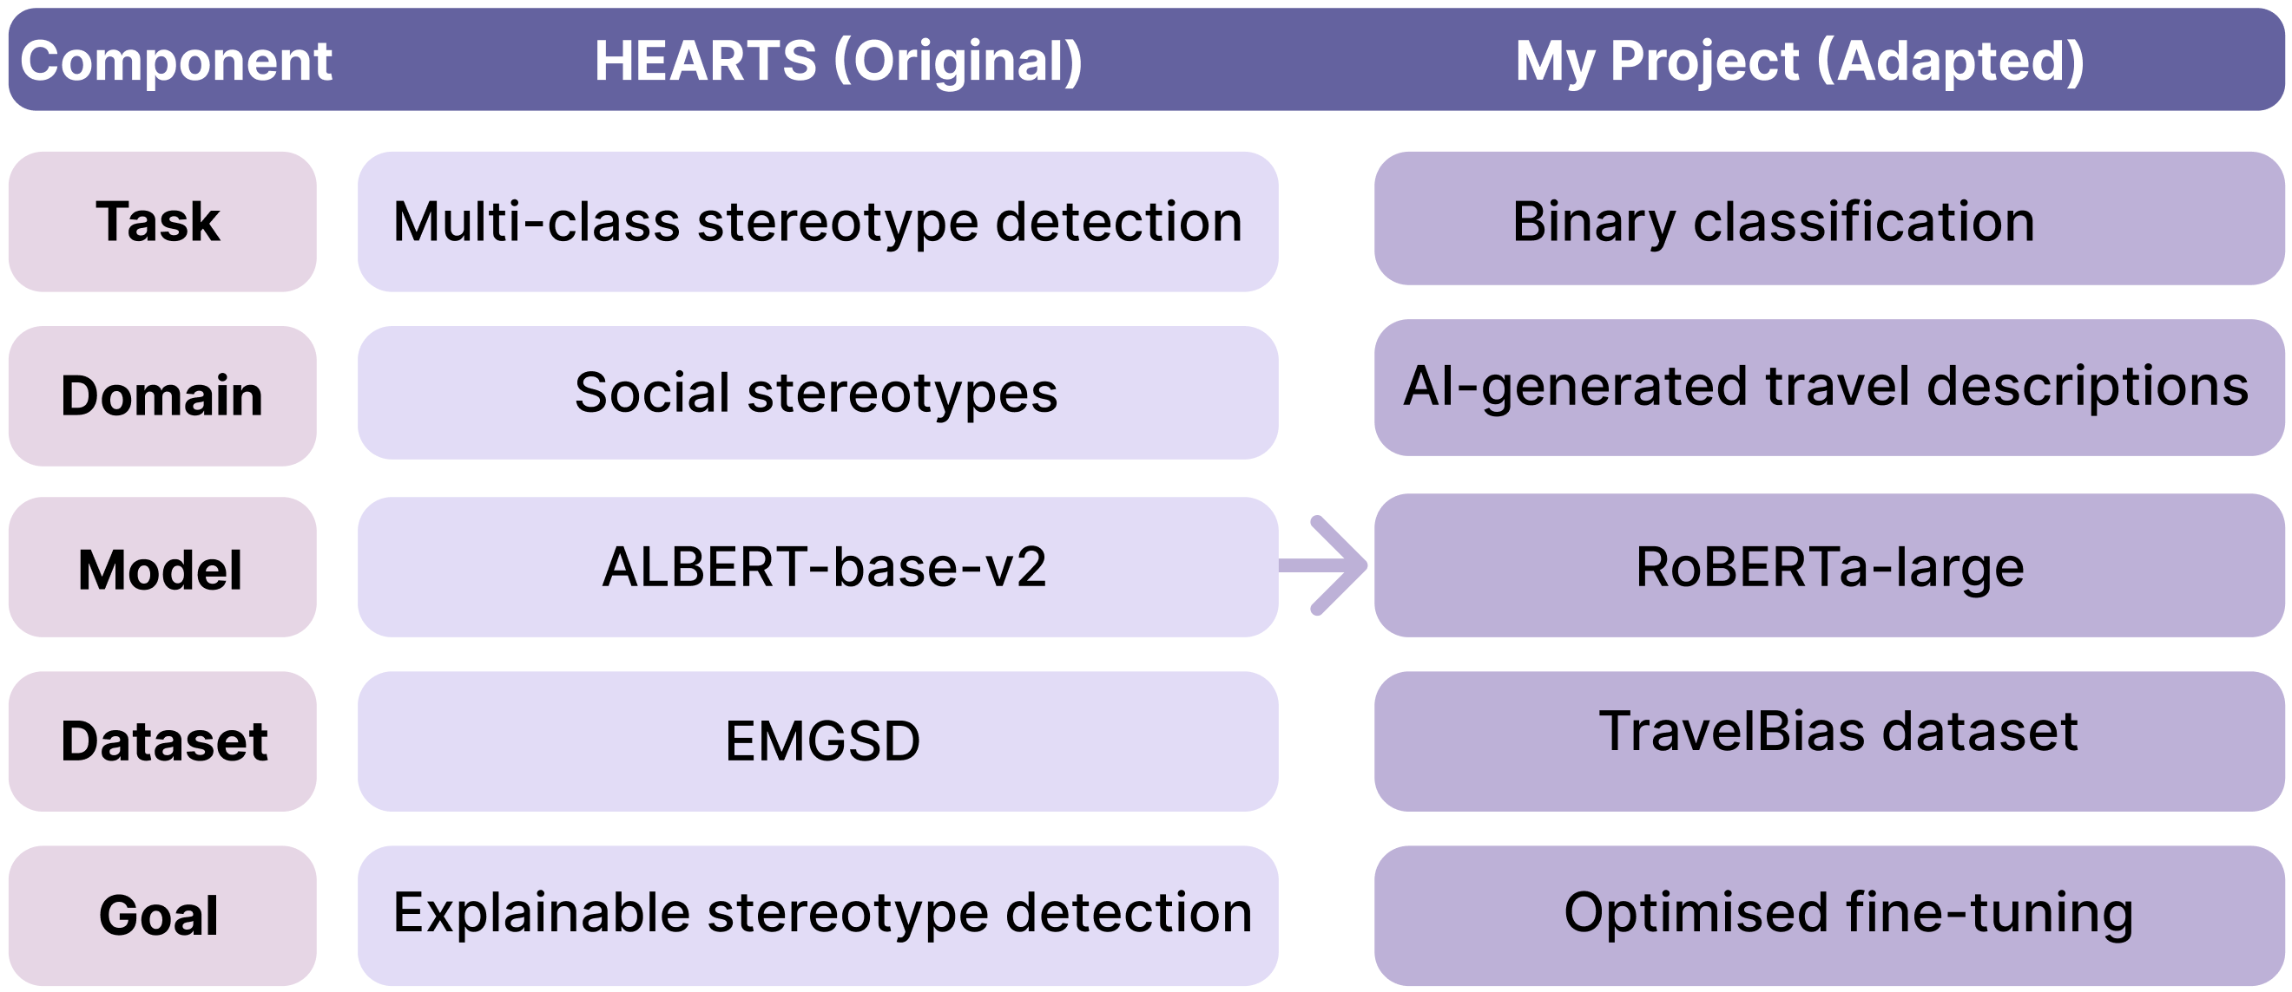
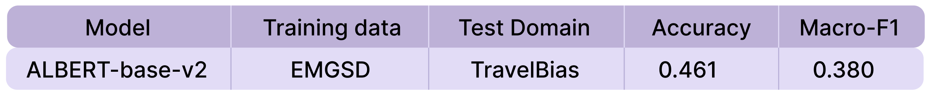
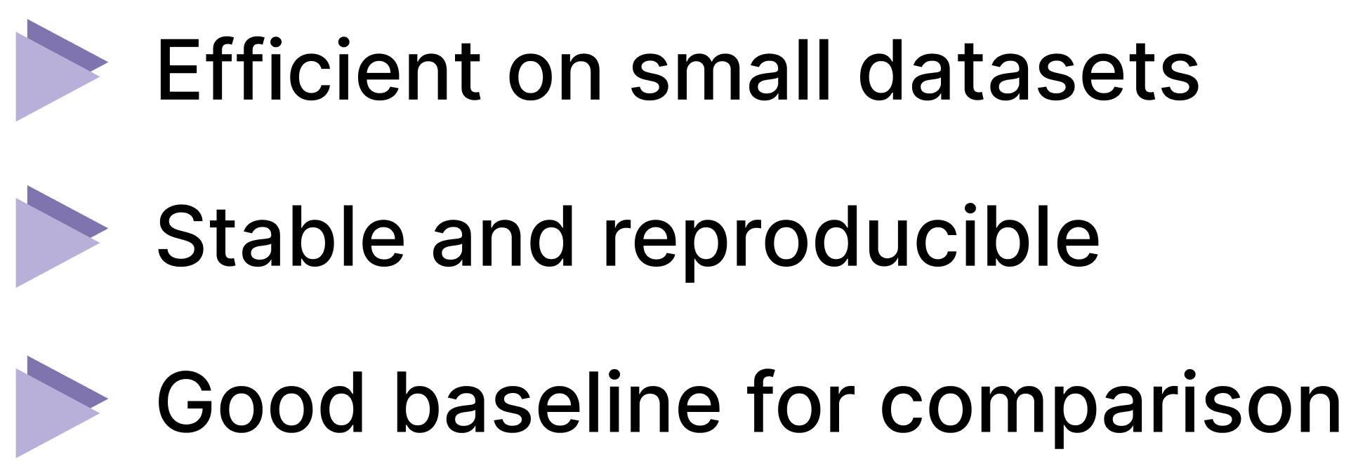
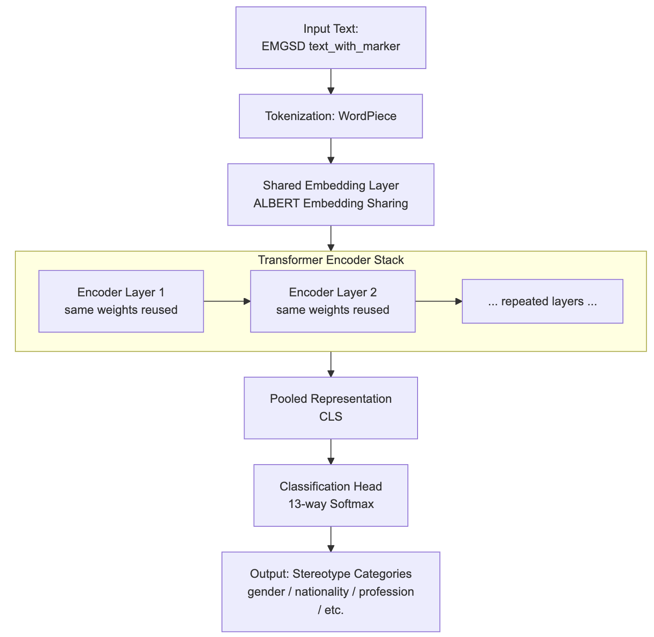
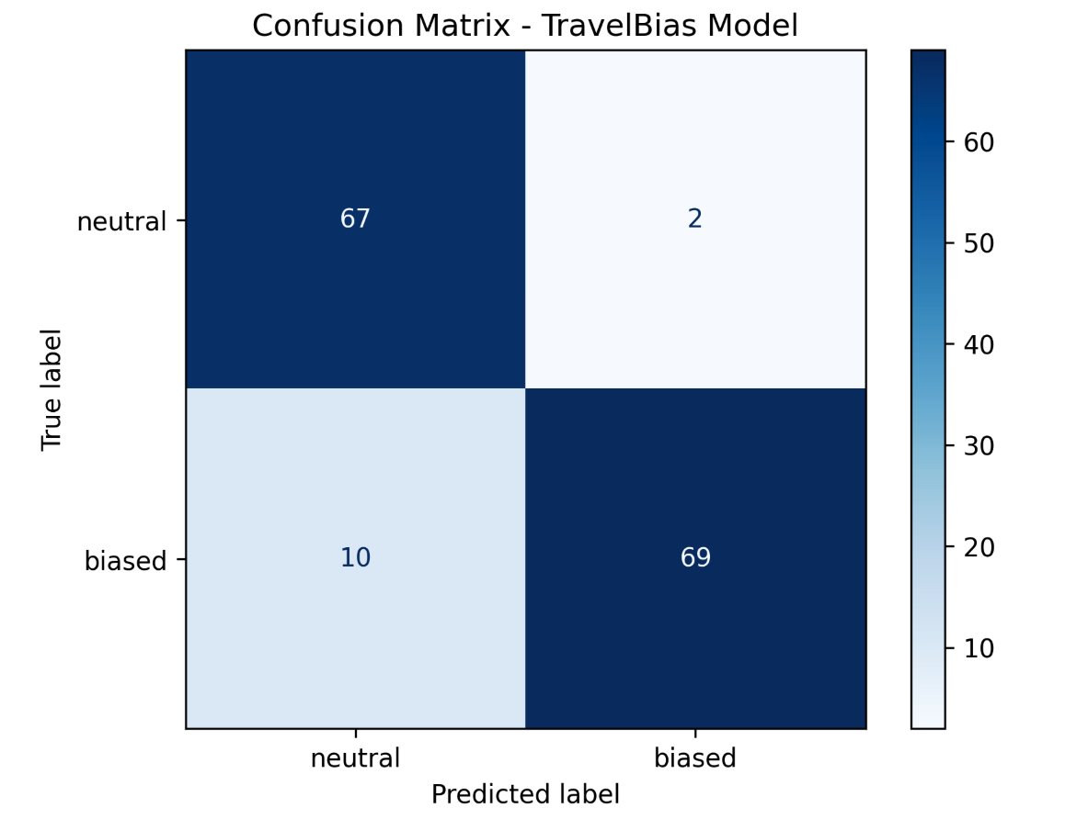
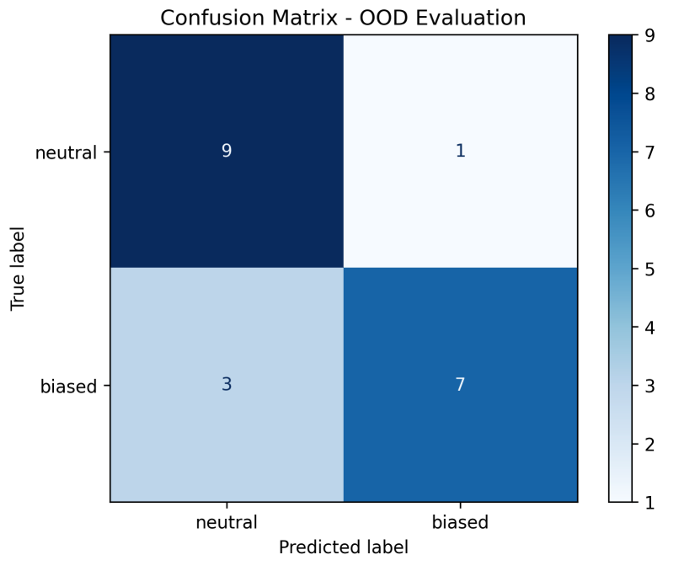
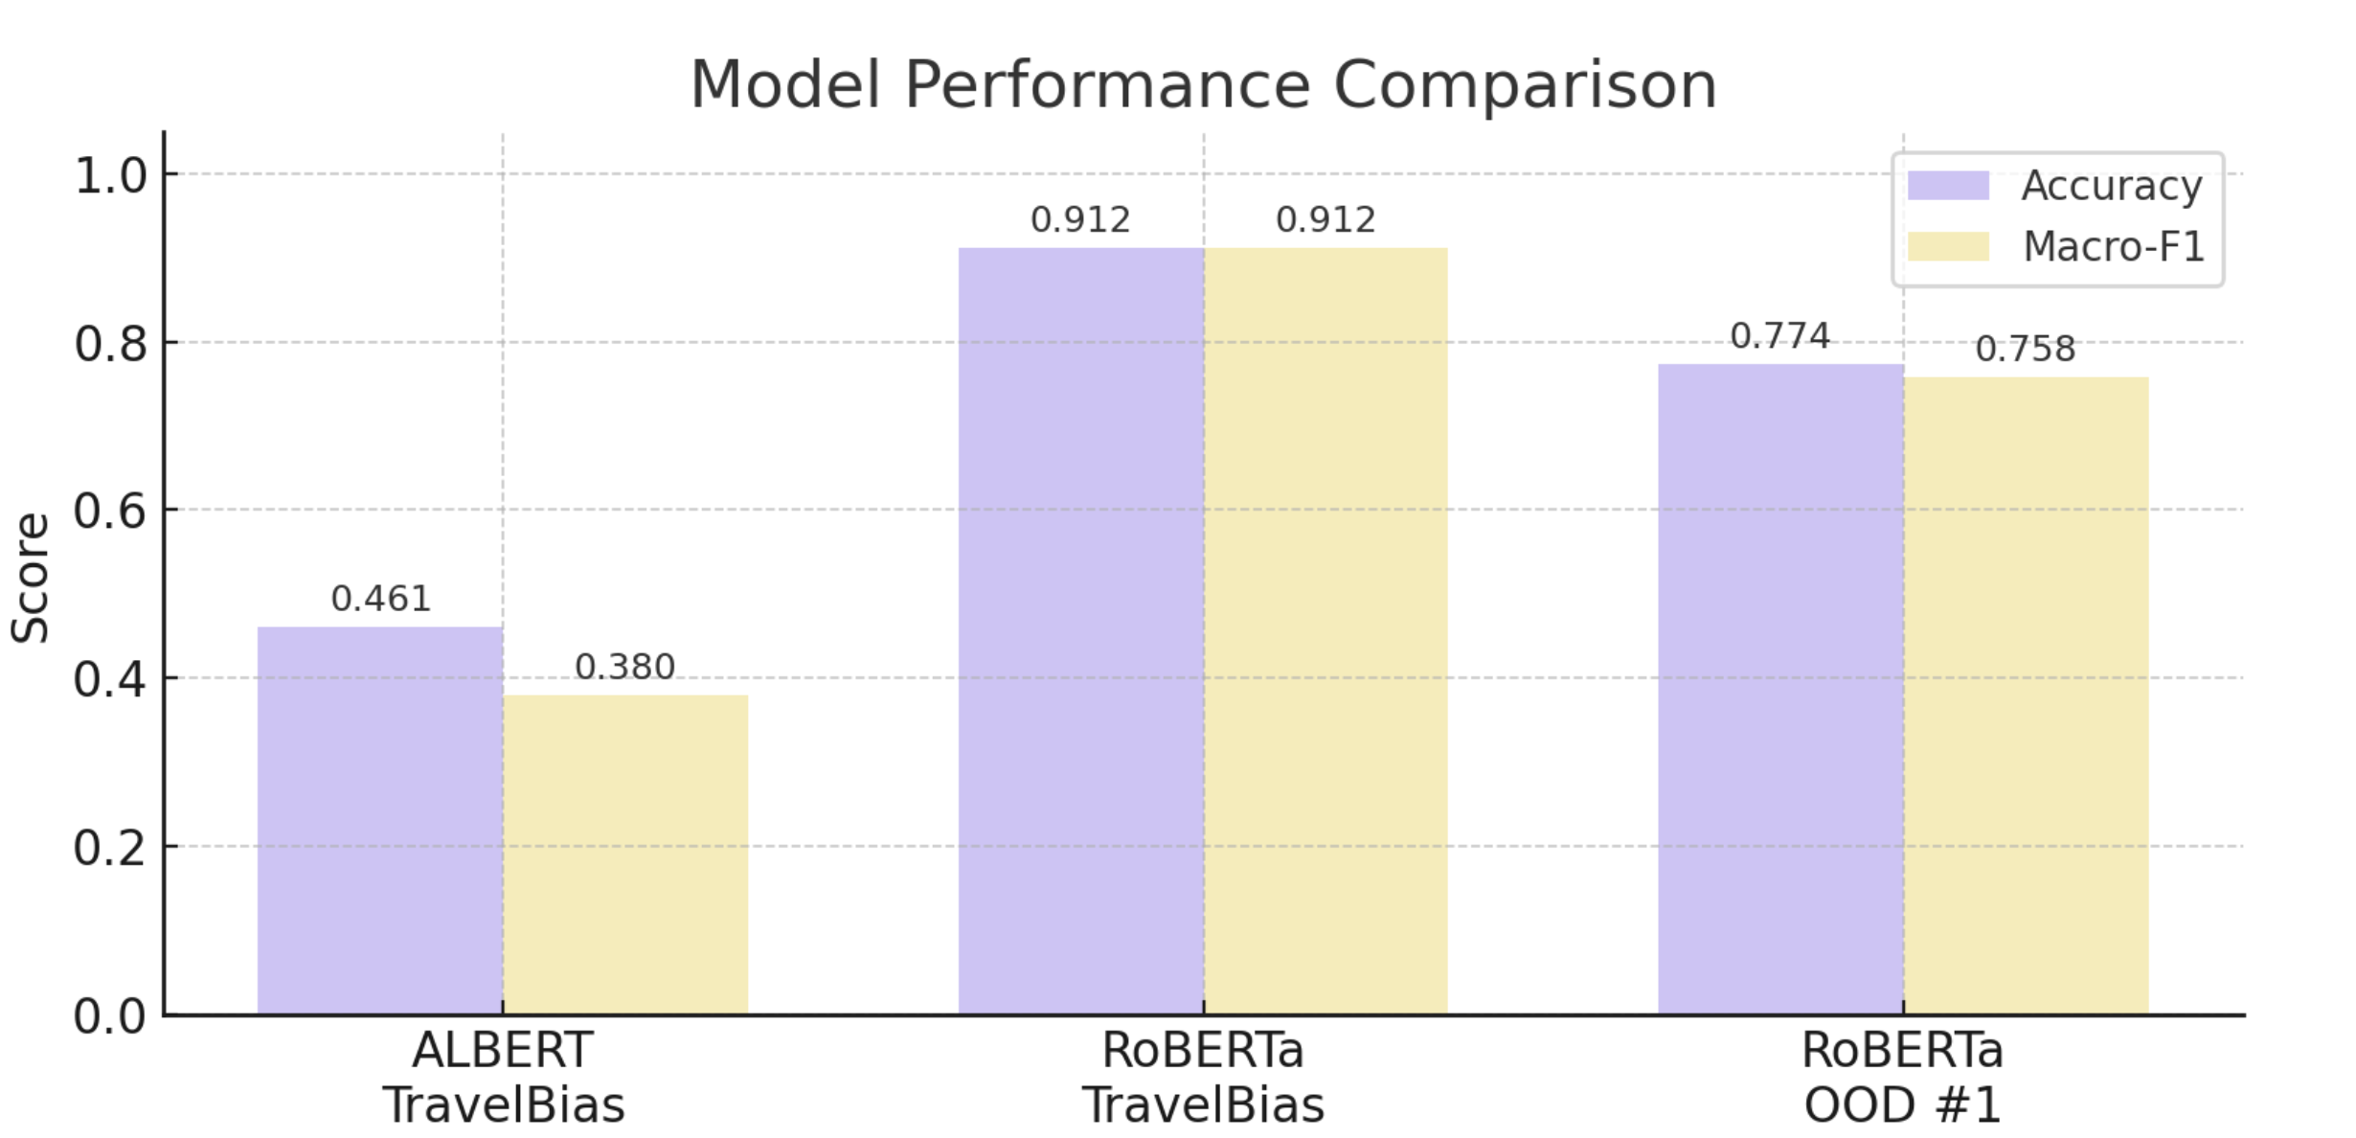
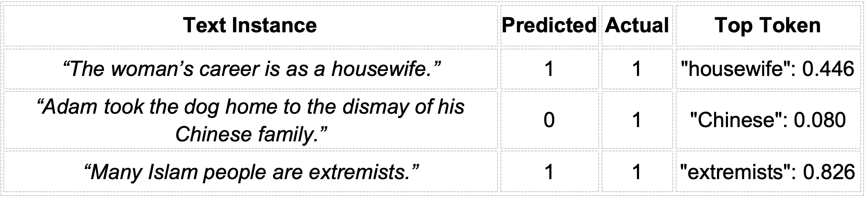
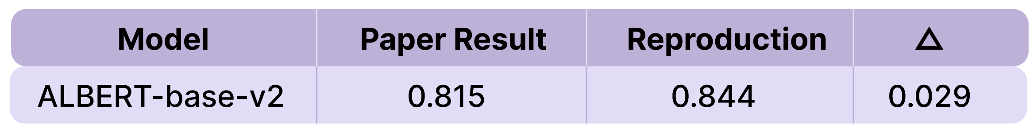
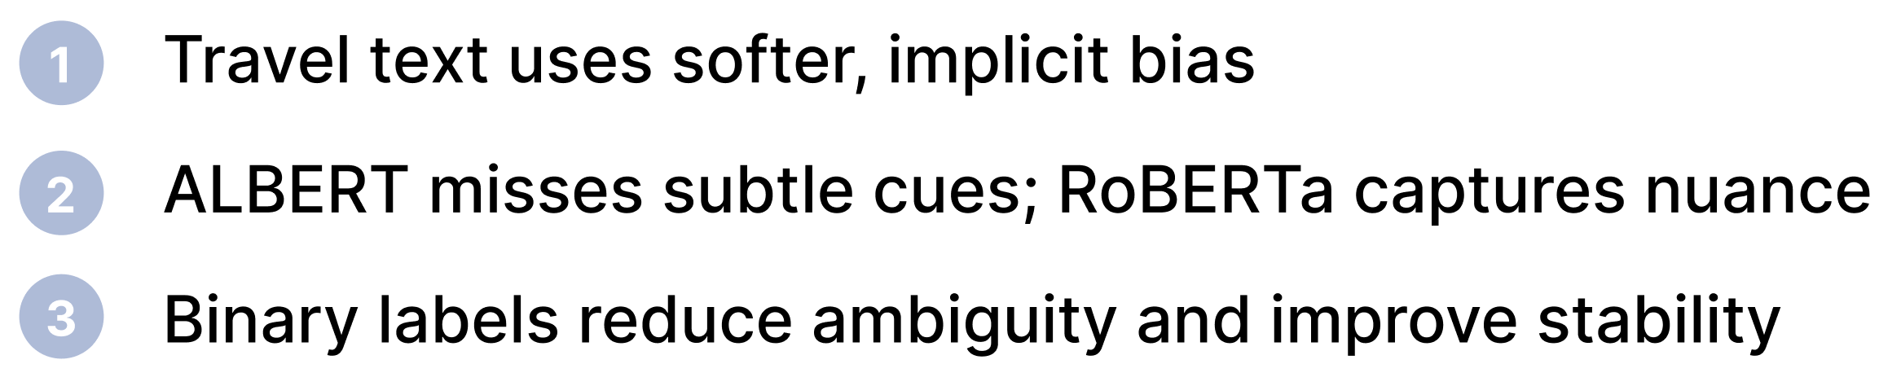

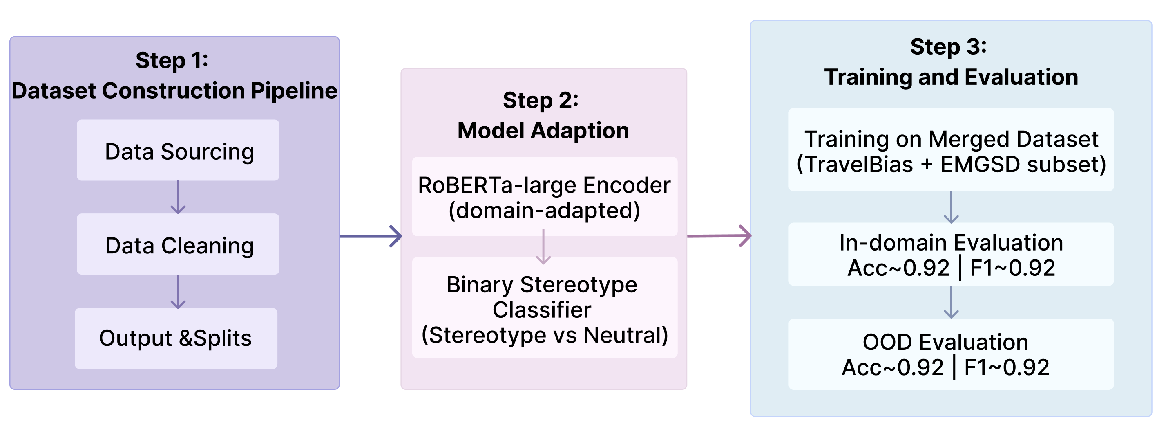
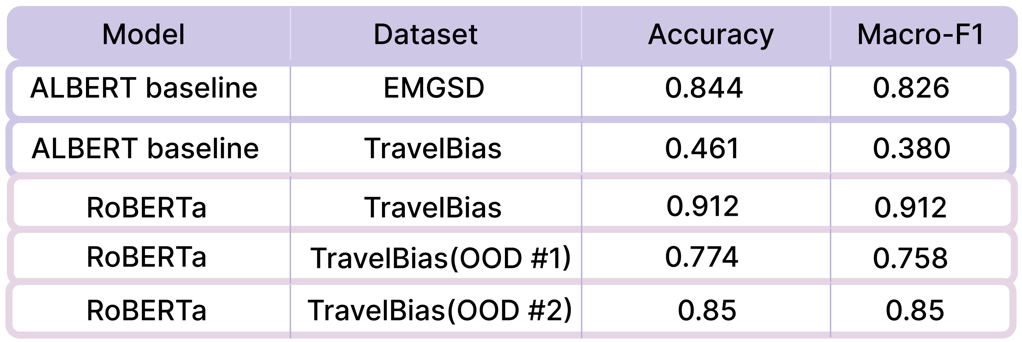
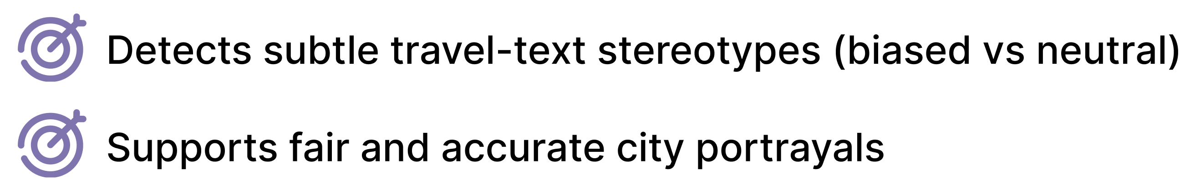
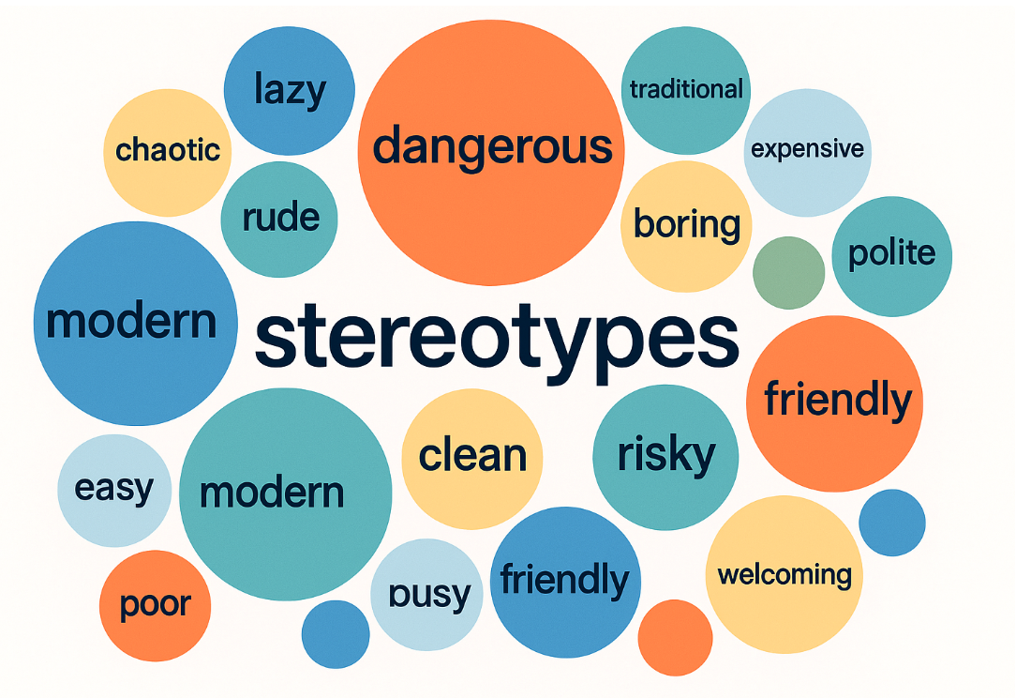



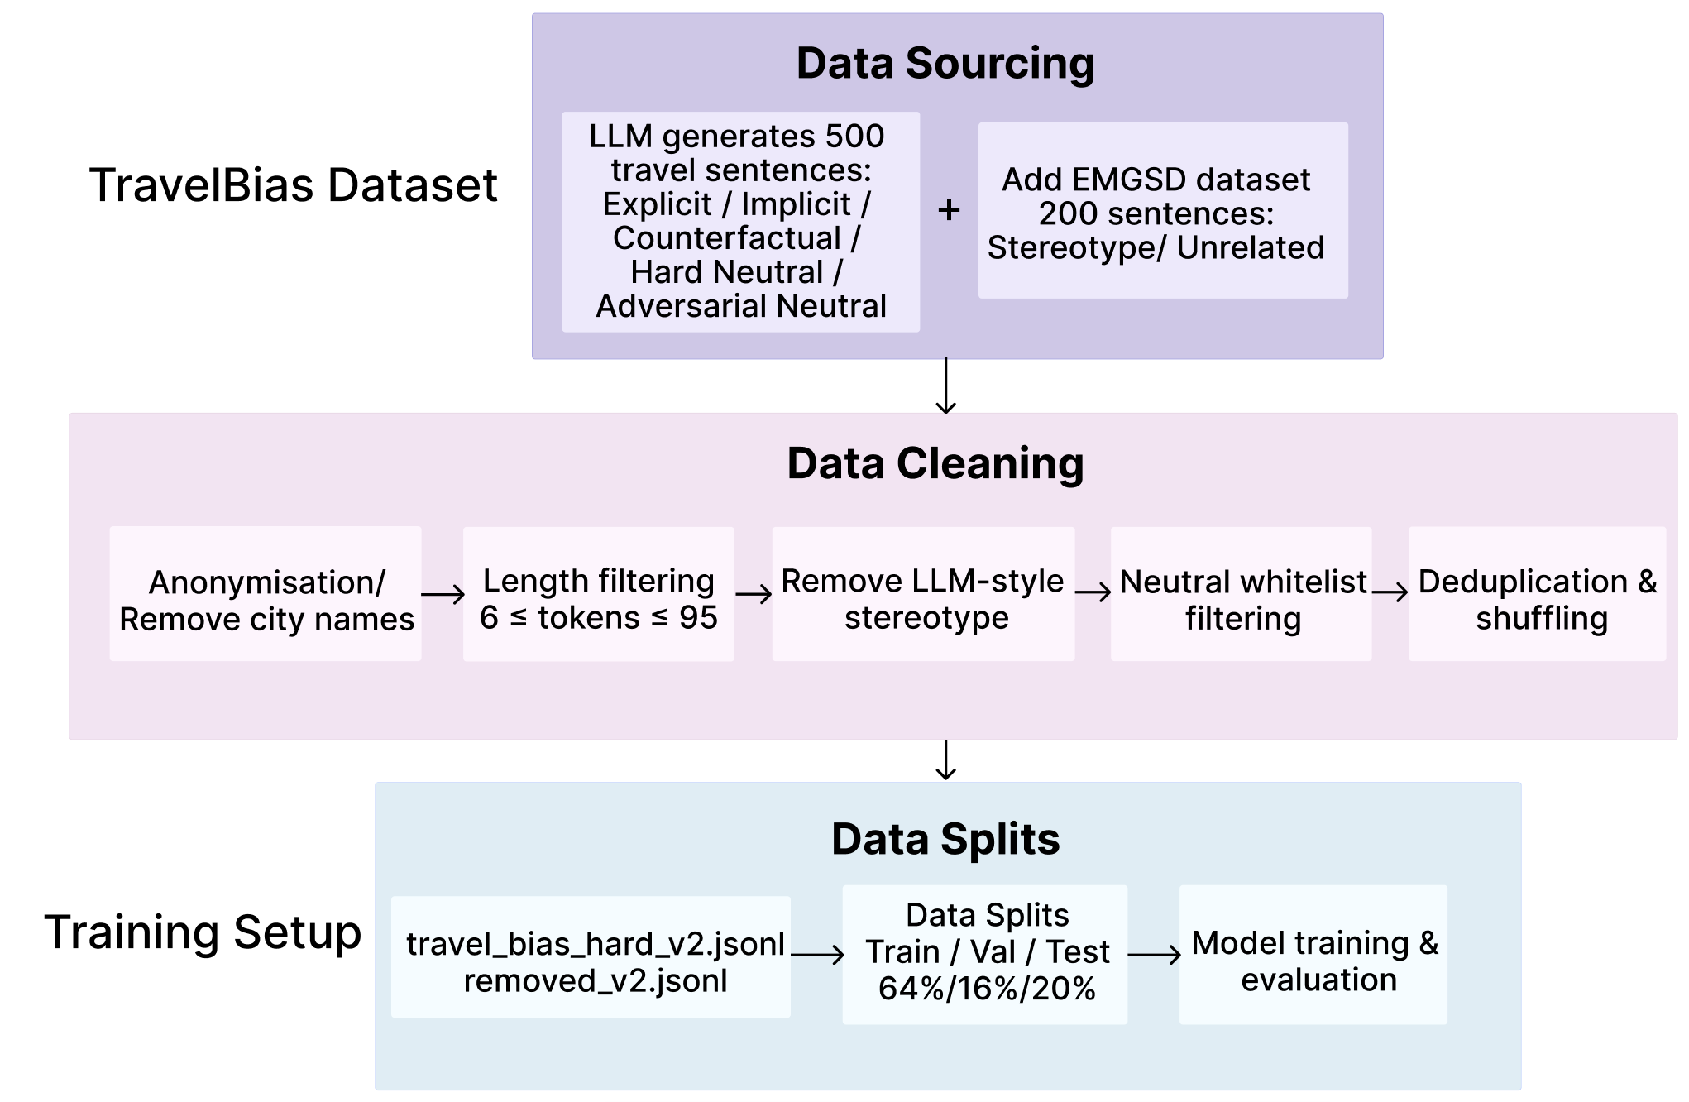
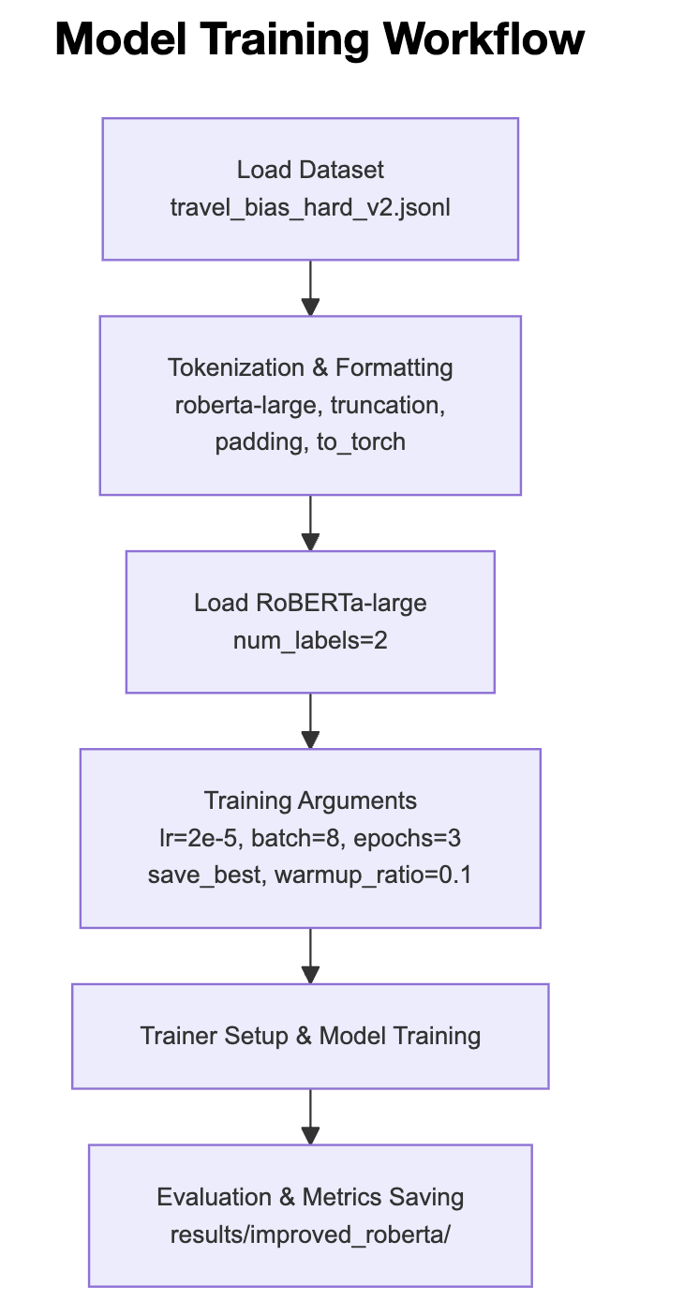
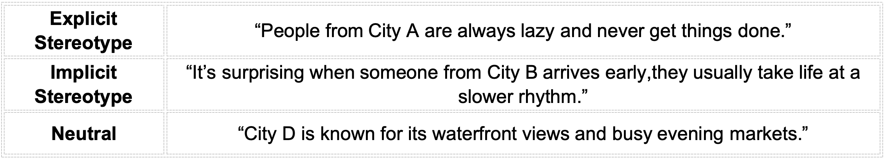

Adapting HEARTS for Stereotype Detection in AI-Generated Travel Descriptions
Jiaqi Wang
University College London (UCL) - Department of Computer Science - AI for Sustainable Development (AISD)
HEARTS Baseline: Method & Reproduction
Adaptation of the Model Architecture
Model Performance
Misclassified Examples
HEARTS: A Holistic Framework for Explainable, Sustainable and Robust Text Stereotype Detection
Aim: Detect stereotypes in text and classify their social dimension (gender, religion, nationality, profession, etc.)
What I Changed - Model Adaptation
Baseline Model Performance on TravelBias (EMGSD → Travel Domain Transfer)
The original paper uses ALBERT-base-v2 as a lightweight, parameter-shared Transformer classifier.
ALBERT Baseline Architecture for EMGSD Stereotype Classification
Adapted Model (RoBERTa-large) Performance
The model is conservative:
It seldom flags neutral text incorrectly, but sometimes misses biased cases, lowering recall.
Why These Changes Were Necessary
Travel Stereotypes: New Domain Challenge
Evaluation of the Performance
AI-generated city descriptions may unintentionally reinforce cultural stereotypes or regional biases, shaping tourist expectations and influencing local communities.
Full Pipeline Overview
Performance Comparison in the New Domain (Travel Text)
SDGs
Datasets
📂 GitHub Repository:
https://github.com/lisaWangjiaqi/HEARTS-Text-Stereotype-Detection.git
Dataset Construction Workflow
The baseline model was trained on news and social media, where biases are explicit.
Travel descriptions are softer and more impressionistic, may not directly align with the HEARTS social categories.
Discussion and Critical Reflections on SDGs
SDG 10 – Reduced Inequalities: Detects travel bias for fair, cross-cultural understanding.
SDG 16 – Peace, Justice & Strong Institutions: Improves AI content moderation by reducing the spread of biased outputs.
SDG 9 – Industry, Innovation & Infrastructure: Shows how bias-detection models can be adapted responsibly to new domains.
Example
Ethical Considerations
Transparent data sources, no personal information.
Neutral annotation to avoid amplifying bias.
Model detects bias but does not generate it.
Reproducible and low-risk research process.
⚠️Limitations
Small, LLM-generated dataset
→ limited generalisation.
Therefore, the baseline model requires further adaptation to perform effectively in this new domain.
🔧Future Work
Expand real travel texts
Clearer labels + explainability.

